Slide 1


Session 2. T24 Navigation and Environment
Transact (T24) Technical Induction Training
Minsk, 2021

Slide 2




Agenda
T24 Navigation and Environment
Application Records
Errors and Overrides
User Abbreviations
AutoID
Multi-languages
Multi-companies
Workshops

Slide 3
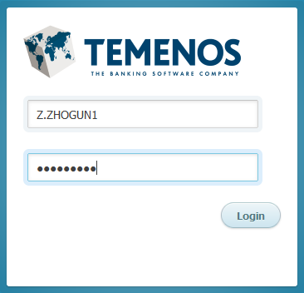

Log into the system through Browser
To log on to Temenos T24 one needs to type the appropriate URL in the address bar
User needs to supply a sign on name and password
Password is masked when typed
Notes:
— T24 Browser is an intranet based front end.
To log on to Temenos T24 one needs to type only the appropriate URL in the address bar. The URL might differ from one installation to another.
Once the correct URL is typed in the address bar, the T24 sign on screen will appear where Sign on name and password have to be specified. Sign on name and password is case sensitive.
Sign on name as well as password can have alphanumeric characters.
After input of appropriate T24 Sign On name and Password, the user can click on the right mark or press enter. If Sign on name or Password information is not correct, there will be an error “Please check your Login Credential and/or access rights”.

Slide 4
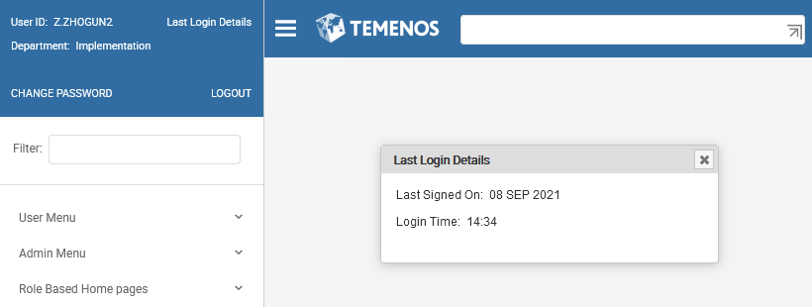
Home Screen
Last Signed In Date & Time
Open Menu
Command Line
User
Menu
Notes:
— On successfully signing into Temenos T24, one will be taken to this screen.
It is designed with menus for users, administrators and specific users under Role Based Home Pages, classified on the general business flow in a Bank. While the above representation is the standard color scheme and template (skin) of Temenos, it is possible to choose different skins.

Slide 5
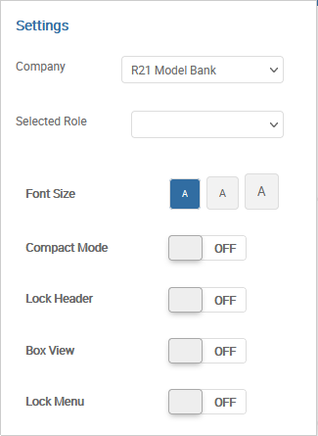

Home Screen
Icons in the right corner of Home Screen
Pin Tool Bar
Refresh Screen
Technical Info
Logout
Delete Cash
Settings

Slide 6
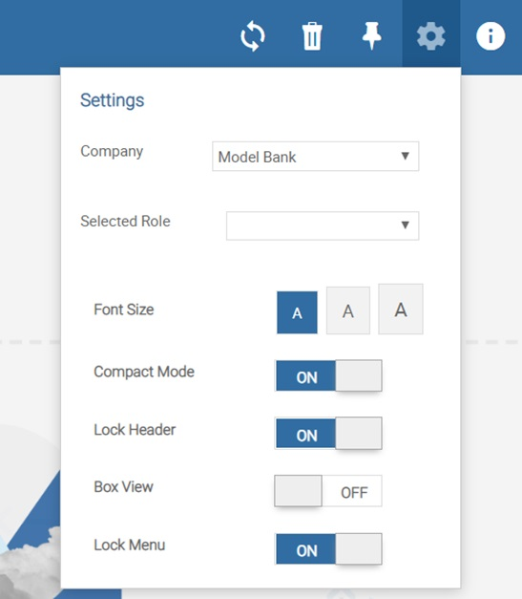
Home Page – User preferences
Using this menu, you can change the current Temenos Transact company and corresponding SMS role.
Font Size – Changes the size of the font used in the screens.
Compact Mode – Determines the spacing between input fields. Setting the mode to OFF gives input fields rounded corners.
Lock Header – Setting it to ON ensures that the top bar (that is, menu, command line etc) is always visible.
Box View – Setting it to OFF ensures that all screens have available width and ON ensures the browser to display with a 1200 pixel of maximum width.
Lock Menu – Makes the menu sticky or non sticky

Slide 7
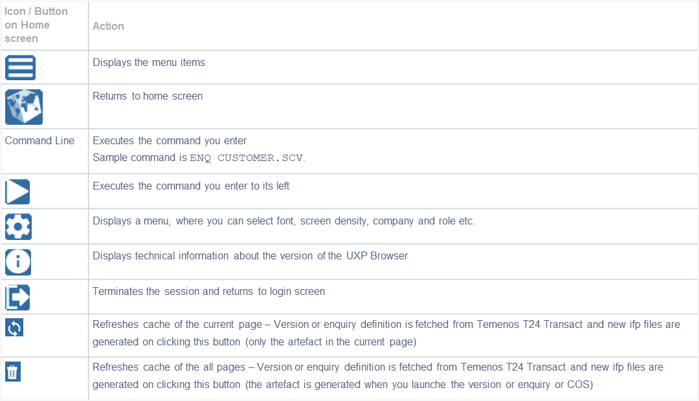
Home Page – Icon/Buttons

Slide 8
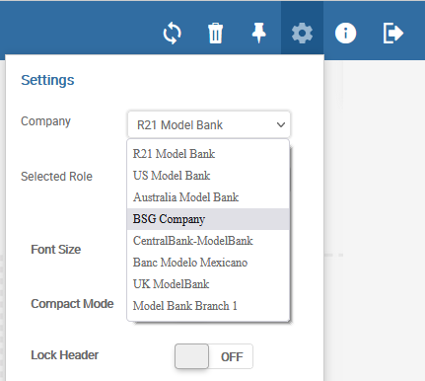

Browser Buttons - Tools
Notes:
— «Company» option allows the user to move or change from one company to another. In T24, normally each branch of a Bank is referred to as a company.
The User will be permitted to change to other companies based on the Security Management System (SMS) access control settings.

Slide 9
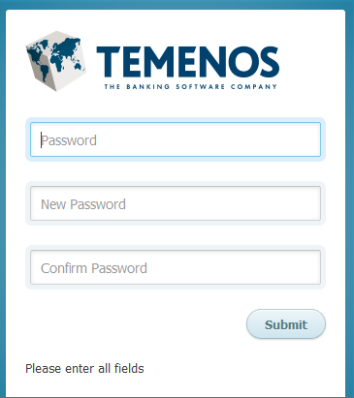
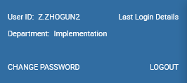
Browser Buttons - Tools
Change Password option allows the currently signed on users to change their password
If the password change is successful, new session will be started.

Slide 10
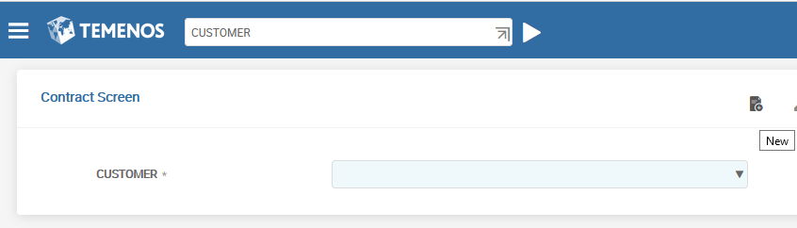
Command Line
Useful to Super Users and Administrators
Type the task in the Command Line and click to execute it
Command
Execute Button
Notes:
— We will now see that the access to the command line is generally useful for super users and Administrators.
When the application name is typed, the next screen will open the application and wait for further input by the user.
Any of the following actions can be done now.
User can see the list of existing records by clicking on the down arrow and then select an existing record.
A new record can be created by clicking on «New» button.
Finally, if the record Id is known, then Id can be input and use one of the three buttons on top. We shall later see more on these.

Slide 11
Modes of opening a new record
Type <Application> I F3 in the command line
Ex: CUSTOMER I F3
Click the NEW icon when application is launched
Use the Menus in the home page
Notes:
— There are various methods of opening a record in T24.
The first method to input a new record is by typing the <Application name> followed by a space and the function for input- ‘I’ , followed by another space and the keys ‘F3’ in the command line.
The most frequently used method to input a new record is to click on the new deal icon when the application is launched. In this illustration you have launched the CUSTOMER application and a new customer can be input by clicking the new deal icon.

Slide 12
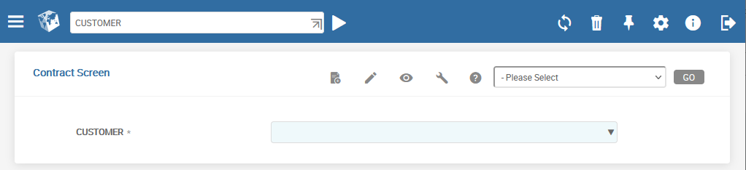
Creating a New record / Accessing an Existing Record
ACTION Button (Authorise, Delete, Reverse & Verify)
EDIT Button
VIEW
List ID’s of existing Records
Notes:
— When an application is opened, the user can input the ID and use any of the buttons depending on the function to be invoked, viz Edit, View and Action button
EDIT Button - Opens a new record for input or an existing record for ammendment
ACTION Button - Opens a record with Authorise, Delete, Reverse & Verify operations enabled
VIEW Button - Opens a record in ‘See’ mode
This is an alternative method to giving the function along with the application and ID in the command line of the first screen.

Slide 13
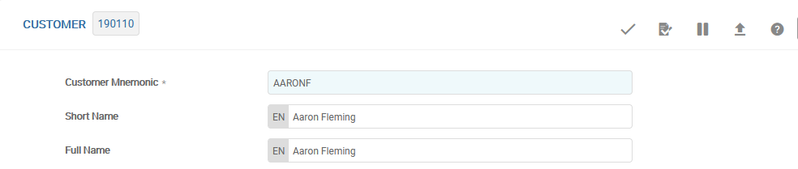
A Sample Record
Application Name
Record Id
Fields
Validate
Validate
Hold
Delete
Authorise
Reverse
Verify
Return
Info
Notes:
What we see here is a sample record in the customer application. The application name and the record Id( Customer number), is displayed. Customer application is a form where the details of a customer are filled. The various buttons that are used to take action on the record is illustrated.
The VALIDATE button is used to validate the data entered in the fields on the form. Incorrect and erroneous information will not be stored in the database.
The COMMIT button will commit the record and save the contents of the record into the corresponding database table.
The HOLD button is useful, when the user does not want to commit the data entered into the database, but at the same time does not want to lose the information input. The data input is saved to be modified, committed or discarded later as per the user’s discretion.
The next set of buttons are Functions enabled on using the ACTION button for an existing record ID. For a NEW record these will be disabled.
In T24, DELETE function is used to delete an unauthorized record. T24 will never re-generate the ID of such a record. Once generated the ID is never re-used unless manually input by the user.
The AUTHORISE function is to be used to authorise the commited record. An authorizer should be different from the user who has input the record.
Any record which has been authorized cannot be deleted and can be removed from the live files only by using the REVERSE function. This moves the record to history.
The button which looks like the NEXT button in the record screen is used to verify a record. This is applicable only for certain transactions.
In FOREX and MONEY.MARKET applications, deals are done at times also through brokers orally. When the written confirmations are later received, verify function is used to record time and date of receipt of confirmation.
The Up arrow button helps user to return to application or the previous screen.

Slide 14
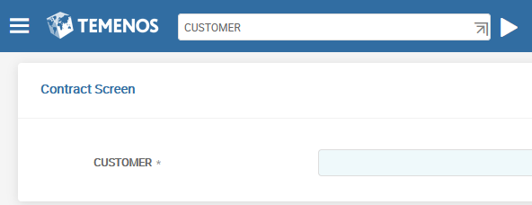
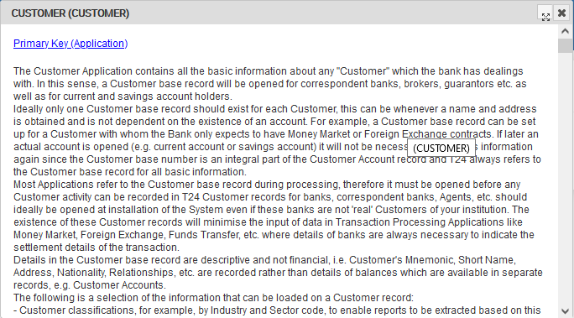
Helptext
Helptext about Application
Single Click on Application name
Notes:
For additional information on any of the fields in an application, click on the Field Label. It opens an online helptext.

Slide 15
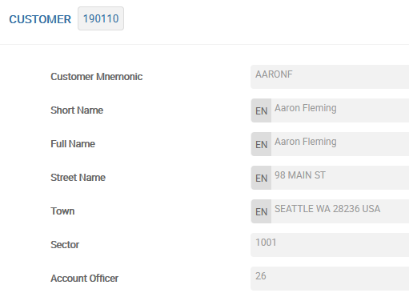
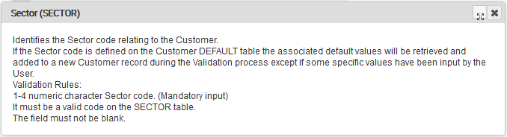
Helptext
Single Click on the Field name
Helptext about Field
Notes:
For additional information on any of the fields in an application, click on the Field Label. It opens an online helptext.

Slide 16
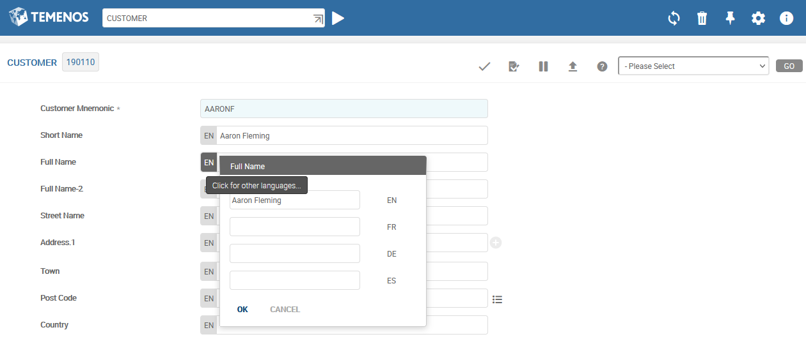
A Sample Record
Sub-Value Expansion. Single Click add a name in another language
Notes:
— One significant and important feature in T24 is called multi value and sub value facility. When a field requires to hold multiple data it can be dynamically expanded or deleted during transaction input stage.
For example, a customer may have accounts in different currencies and may want his name to be displayed in the regional language of that currency. To facilitate this, multivalue the Name field as shown. Sub-value is a second level of doing this.

Slide 17
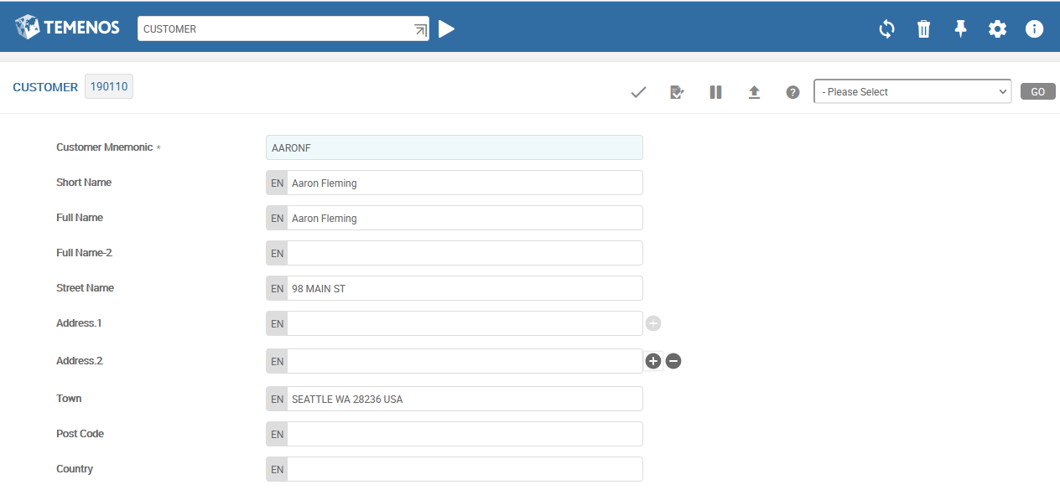
A Sample Record
Expand Multi-value
Delete Multi - Value
Notes:
— For example a customer may have an office address and a residence address that you want to store. You Multi-value the Address field. If each the office address needs to be stored in multiple languages, then sub-value the address field.

Slide 18
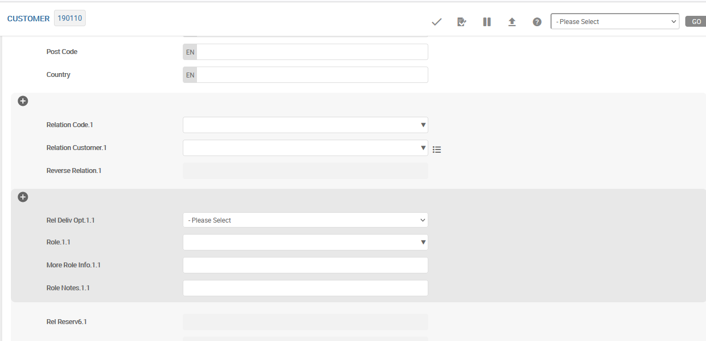
A Sample Record
Expand Multi-Value Group
of fields
Expand Multi-Value Group
of fields inside another Group. It is Sub-Value Groups

Slide 19
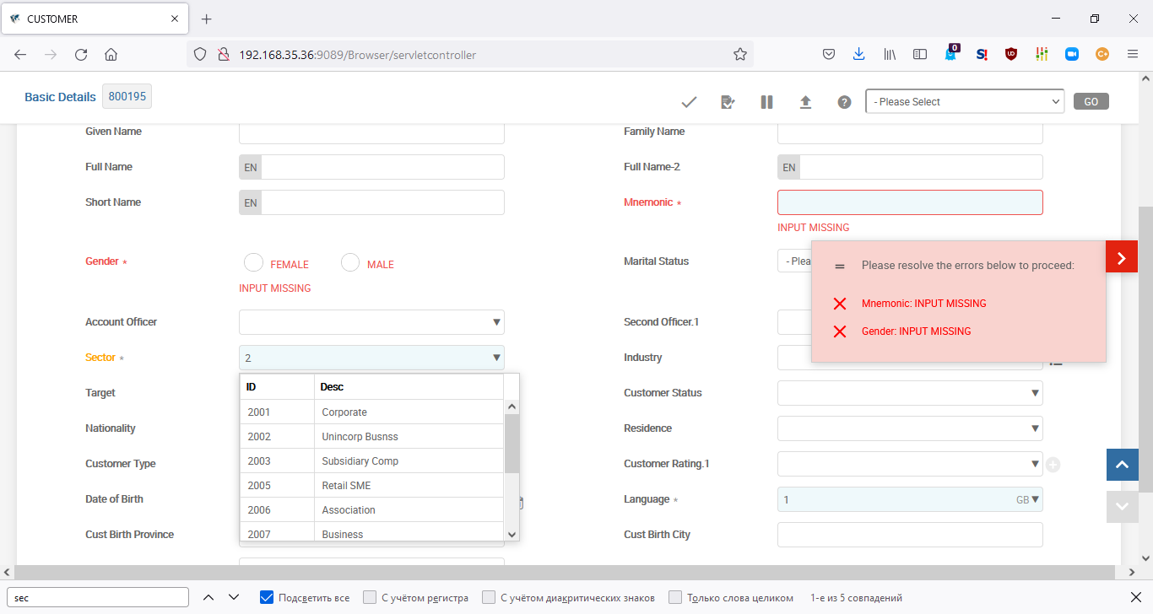
A Sample Record
Enrichments and Dynamic Lists
Dynamic lists are input fields where you can enter a key directly (if known) or use a drop-down list to help them choose. This list can be filtered by the value entered manually. So if you enter 2 and then click the drop-down icon, the list displays only keys that have 1 anywhere in the key:
Single Click
After entering or selecting a value and then tabbing away from the field, the UXP browser displays the enrichment text right justified in the input box.
Enrichment

Slide 20
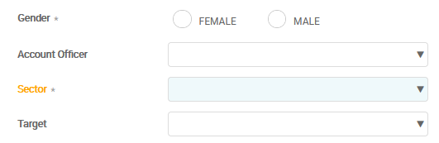
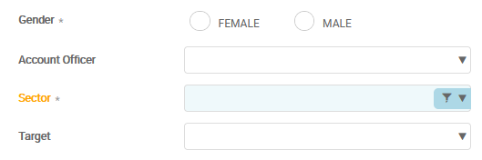
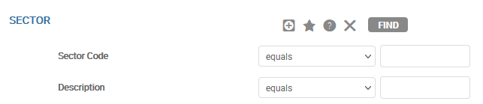
A Sample Record
Enhanced Picker
Hovering over the icon displays the following:
Selecting that button launches a parameter driven enquiry. This allows you to filter the corresponding data based on selection parameters of their own choosing as opposed to just filtering based on the key
Step 1: Hovering over
Step 2: Single click
Step 3: Enquiry launched

Slide 21
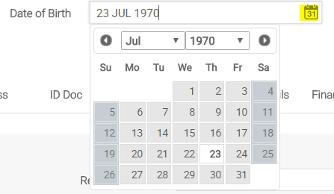
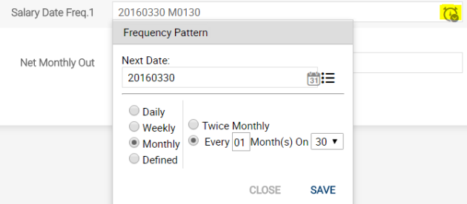
A Sample Record
Date or Frequency Fields
You can enter a date directly (or frequency) into the input fields or use the helper widget.
Sample date field and Frequency field are shown below.
Single Click
Single Click
Notes:
— Calendar pop ups are available for appropriate fields to enable selection of dates for a transaction.
For ease of input of frequency type of value, certain popup are available which displays a dialog box for giving the next date and frequency thereafter.

Slide 22
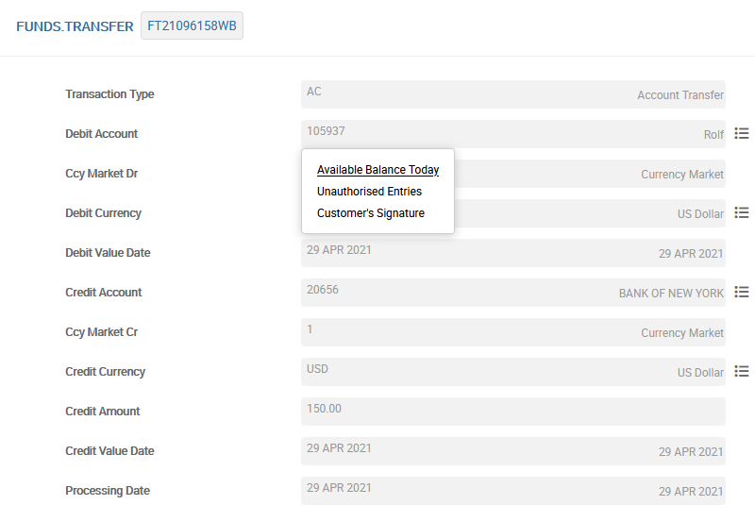
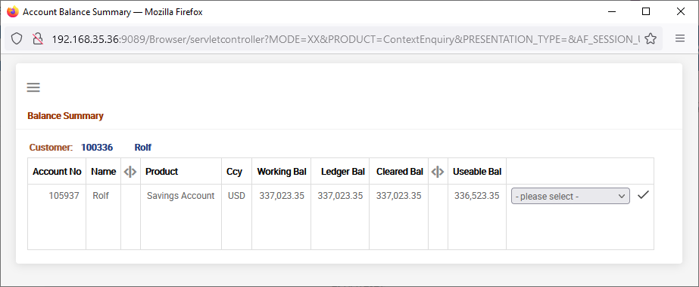
Context Enquiry
Context Enquiry. Single Click
Context Enquiry
Notes:
— The Button to the right of the field is useful to invoke context sensitive enquiry which is predefined in the system.

Slide 23
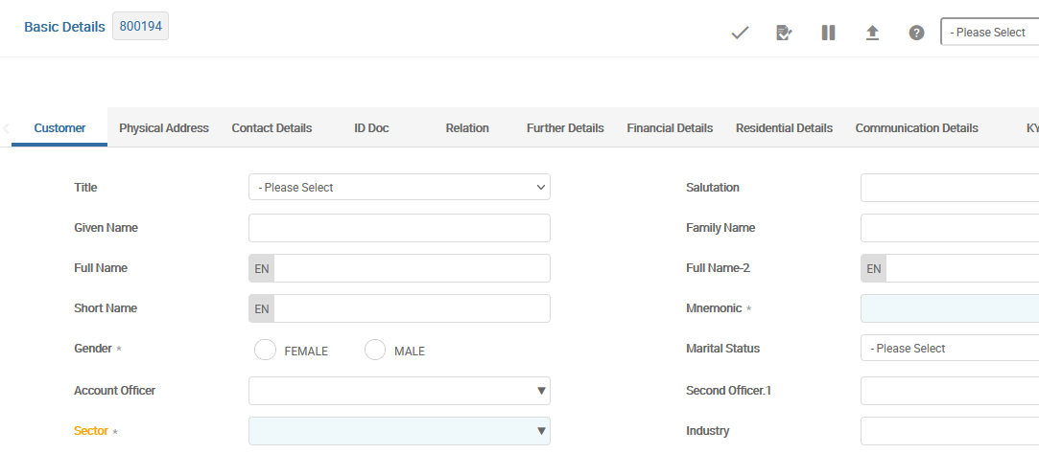
A Sample Record
Hot fields
Entering or changing a value in the hot field, then tabbing away allows the UXP Browser to validate all the fields on the screen. These fields have orange labels:
Hot field

Slide 24
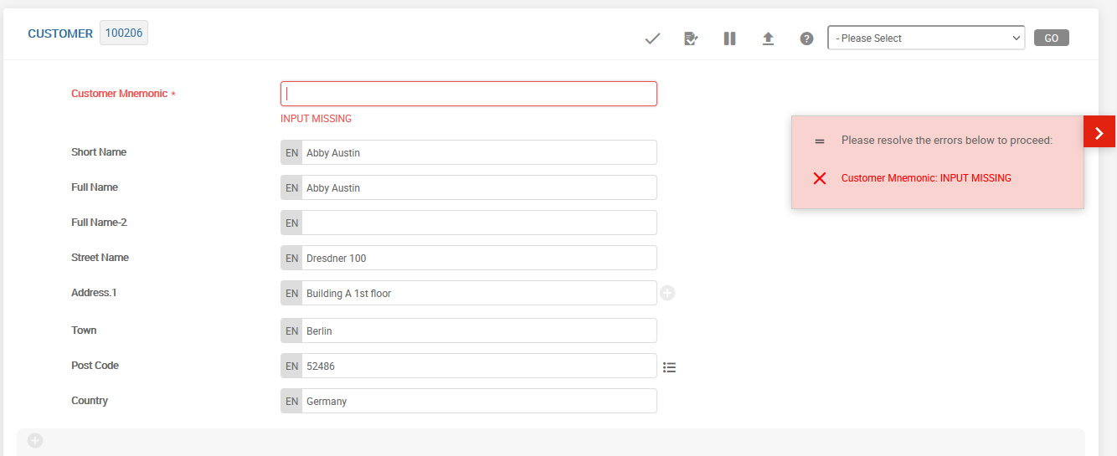
A Sample Record – On Validation
Validates the data in the form
Notes:
—
When you enter data into a form in T24, you must first validate the data before storing it in the database. The validate button on the form facilitates this. On clicking the validate button after data input, it can result in 2 possible outputs – Errors or no errors.
On clicking the commit button, the validations are executed again before the record is stored in the database.

Slide 25
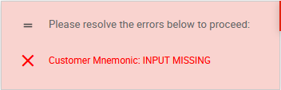
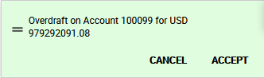
Types of Messages in T24
In T24, when you commit a record, two types of messages can be displayed:
Error Message:
Override Message:
Notes:
T24 displays different types of messages.
The first one is raising of error messages.
When input is incomplete or with incorrect data, the system raises error message while the record is committed.
To proceed further, the error messages that are displayed along with the field needs to be corrected.
By clicking on the field name displayed, the cursor moves to the particular field to enable correction.
The record cannot be committed without rectifying the errors displayed.
There is another type of message called Override message.
Whenever there is a deviation to the specific setup in the system, a warning message is raised by T24.
Certain types of these warnings are called as overrides and such messages can be accepted by the user or not. If accepted, then the input is saved and the message is recorded in the transaction.
If the user does not want to accept, the application should either be closed or the situation pointed out should first be rectified.
For example, when a transaction results in over drawing the balance in an account, an override message is displayed stating that the balance exceeds arrangement or it is an un authorised over draft depending on whether the account has overdraft facility or not.
Another type of message is for confirming whether or not pre-defined documents have been received.
They are generated by DOCUMENT.MANAGEMENT application.
Here, both the choices, Received and Not received are stored appropriately.
For example, when there is a setup for receiving documents for opening an account, the user can record whether the same have been received or not, but continue with the completion of the transaction.

Slide 26
Errors
Displayed when committed / validated
Field names and error text displayed
Record cannot be committed without correction
Clicking on the message takes you to the respective field to correct the input
Notes:
Error Messages: Such type of messages are displayed -
Due to data not being input in mandatory fields
Due to incorrect data input
Due to incorrect relationship between field name and the data that is input.
In case of Error Messages, you need to correct the data input in the particular fields and commit the transaction again.
A record is not saved till all errors are corrected.

Slide 27
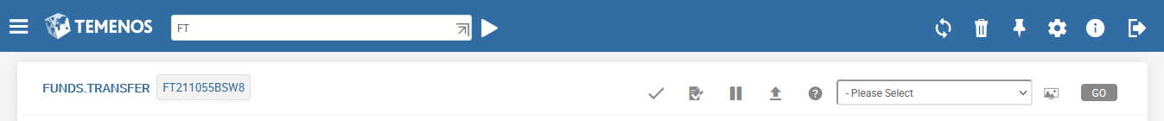
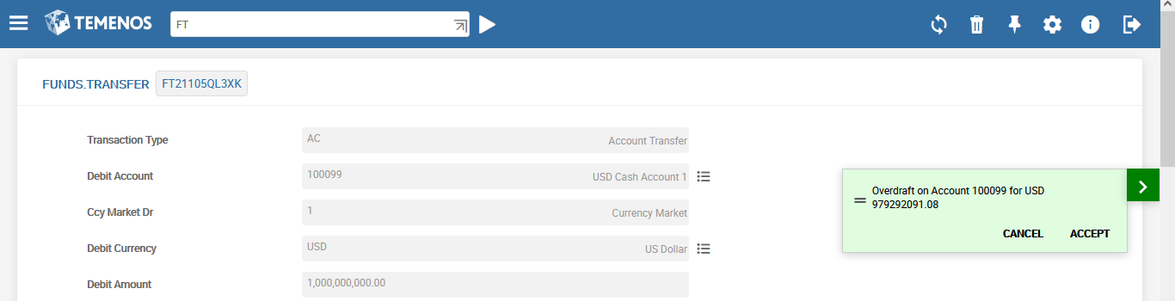
A Sample Record – Commit
COMMIT
Override
Notes:
Once the Errors are rectified, click on the COMMIT button. The outcome of this action may result in overrides getting generated or no overrides. Overrides are warnings that get generated on committing a record in T24. You have to accept the overrides to save the record in the database as an unauthorised record. On clicking the commit button, the validations are executed again before the record is stored in the database.

Slide 28
Overrides
Override is a warning message generated by applications
Override is a configurable error in the system, i.e. the bank can decide to classify them as errors, if required
They are customized, based on Channels, amounts, currencies, type of transactions etc.
Notes:
An override in T24 is required in a situation where the user needs to be warned that he has to confirm the action which he would be performing.
For example, A customer wants to withdraw $100 from his savings account which has a balance of $150. Assume that by T24 norms, the minimum balance in the savings account should be $100. Now if you input the transaction to debit $100, when committing it T24 must warn you about the insufficient funds available. T24 cannot stop you, but it can warn you. T24 generates an override to do this. You will have only two options, to accept it and complete the transaction or reject it and stop.
1.2 Override Messages: These are warning messages, at least most of the time. A user may accept or reject override. If accepted, T24 saves the record and the override message is stored as part of it in the field OVERRIDE. If you do not want to accept the Override, you may either put the record on hold to correct it later or amend the record and commit it again.

Slide 29
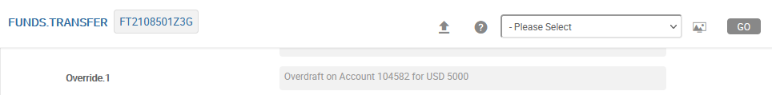
Override Field In T24
Override field
Part of almost all applications in T24
All override messages that have been generated by the system for that transaction get stored in this field
Multi-value field – since multiple messages may be generated in a single transaction
No-input field
Notes:
‘Override’ is the name of the field which stores the override messages generated on committing the record.
1.1 This field is part of almost all the applications in T24.
1.2 It is a no input field and updated by T24.

Slide 30
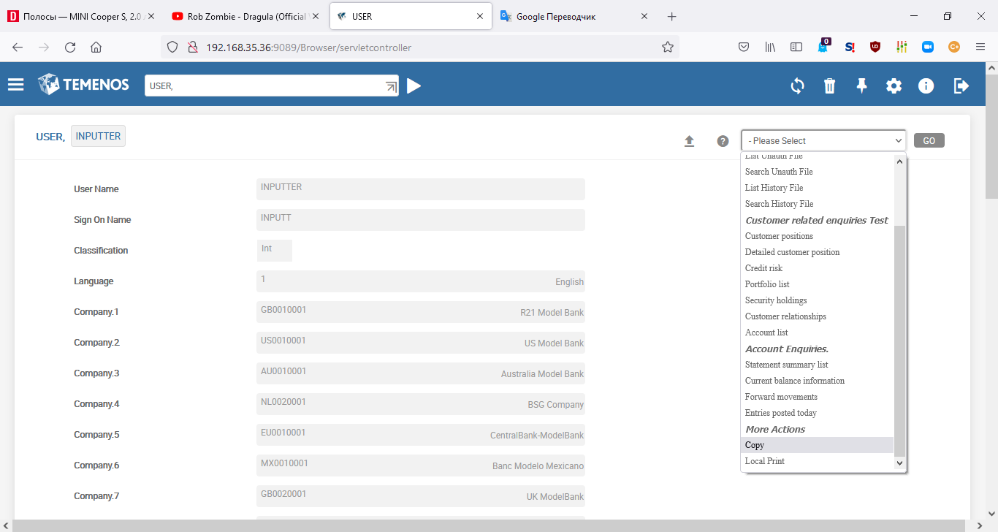
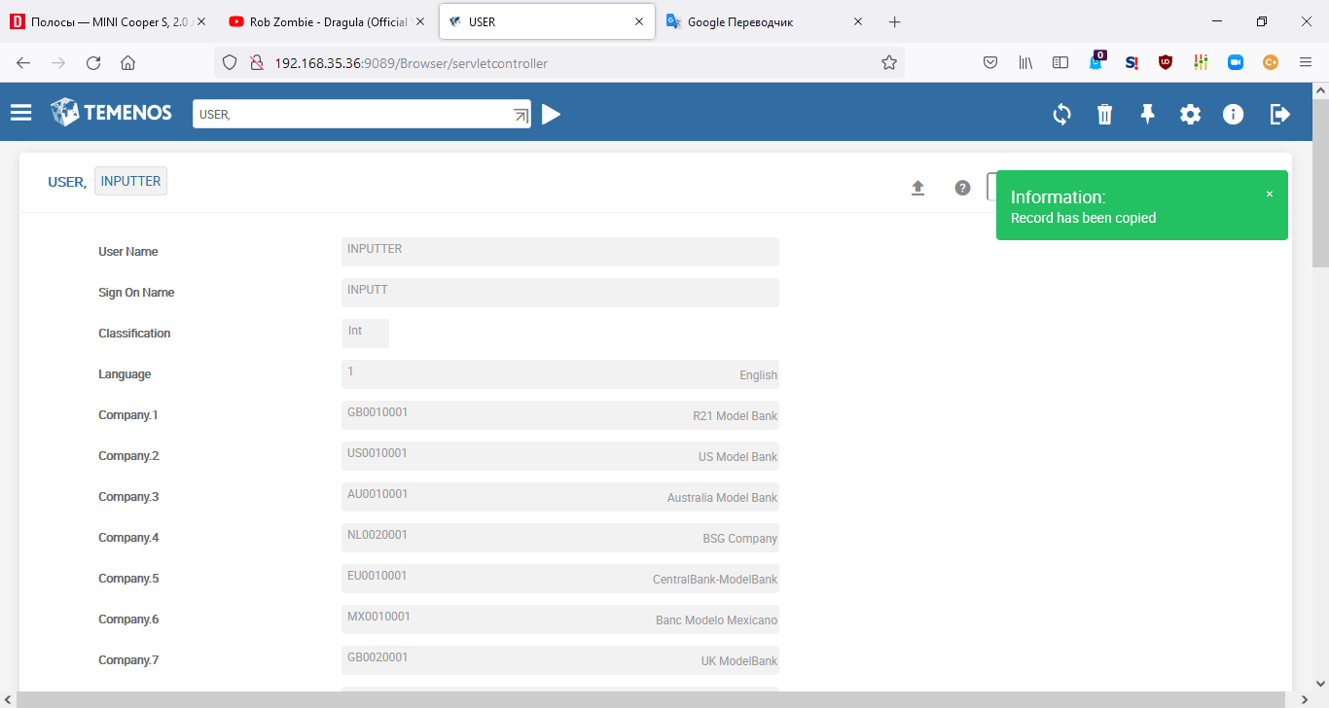
Copying Records
Success Message
Copied records remain in the clipboard till logging off from the session.
Copy
Notes:
To copy an existing record, it should first be opened.
Thereafter, pick the option Copy from the drop down in the More Actions available at the top.
Copied records are stored in clipboard.
Copied records remain in the clipboard till logging off from the session.
Copied record should be suitably pasted to a new record.
Copying and Pasting are two different actions.

Slide 31
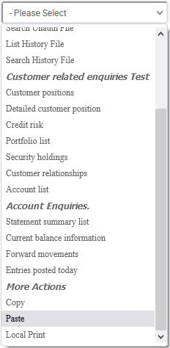
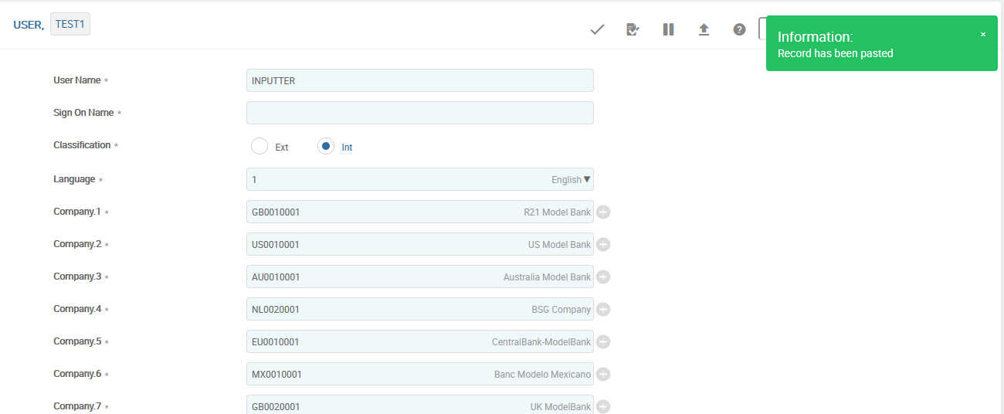
Pasting Data
Success Message
Unique value needed
All the values from the copied record get pasted except for fields which need unique values.
Paste
Notes:
To paste a copied record, User should go back to the application and open a new record into which the copied details are to be pasted.
When T24 displays a blank record opening screen, using the paste option in the More actions drop down, the last copied record is pasted onto the blank record.
All the values from the copied record get pasted except for fields which need unique values.
Those fields have to be physically filled before the record could be committed.
If any other field value is to be modified, that could also be done now.

Slide 32
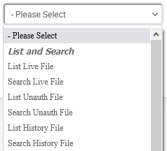
Deal Menu Options – LIST and SEARCH
Two options that can be used to search files
LIST to list everything
FIND to list as per selection
Both options search on Live, Unauthorised and History Files
Selection operands for FIND option are
Equals Not equal to
Greater than Greater than or equals
Less than Less than or equals
Between Not Between
Contains Not Containing
Begins with Ends with
Does not begin with Does not end with
Matches
Notes:
List - Lists all the records available in the application in the appropriate files namely, unauthorised, live and history.
For example, if a list of all the transactions that require to be authorised is required, then the list option of the unauthorised file is to be selected.
Find – This is an option by the required files could be found by filtering the records in live or un authorised or history files. For this purpose a selection box is displayed for the user give the criteria.
To specify the criteria, the user can use any of operands like Equals, Not equal to, Great than, Greater than or equals, Less than, Less than or equals, Between, Not Between, Contains, Not Containing, Begins with, Ends with, Does not begin with, Does not end with and Matches.
The operands Equals, Not equal to, Great than, Greater than or equals, Less than, Less than or equals are used for comparison of numeric values.
Between and Not Between can be used when a range of numeric values are to be compared.
The two numbers are specified with a space between them, for example, to select values from 30000 to 35000, it is specified as 30000 35000.
The remaining operands are used for locating alphanumeric or string values.
Contains and Not containing will select values with the string value anywhere in between the field value.
Begin and End with will locate for strings in the beginning and end of the value.
Matches identifies exact values for the string.

Slide 33
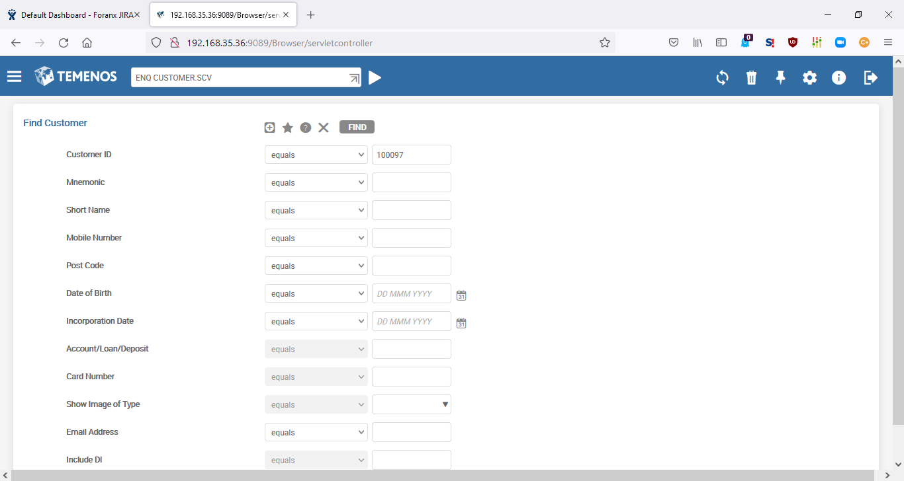
Enquiry - Enquiry selection
Enquiry selection is an input screen where you can specify a set of data filters. This screen appears when an enquiry is launched and it will be skipped in case the enquiry is run with some pre-determined filter.
The example (ENQ CUSTOMER.SCV) displays the customer ID with the value of 100336.
You can click to delete whatever you have entered and reset the screen to its original state.

Slide 34
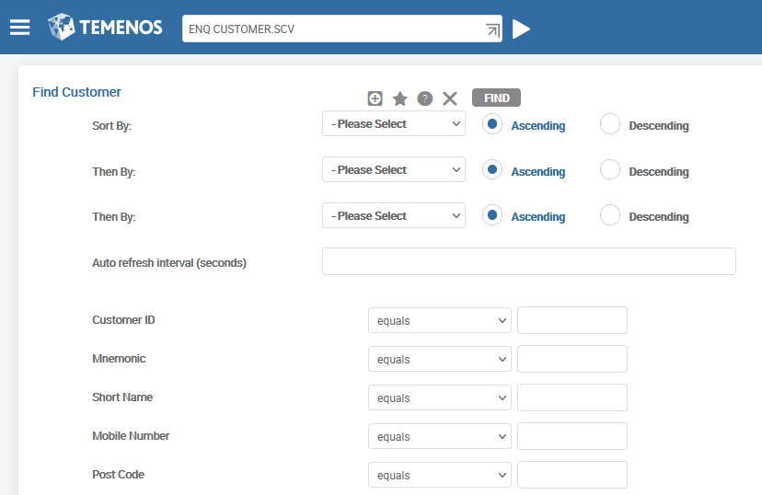
Enquiry - Enquiry selection – Sort Ordering
Sort options. Single Click
This section displays the sort options with the Enquiry selection or filtering fields. Each dropdown contains a list of fields to sort by.

Slide 35
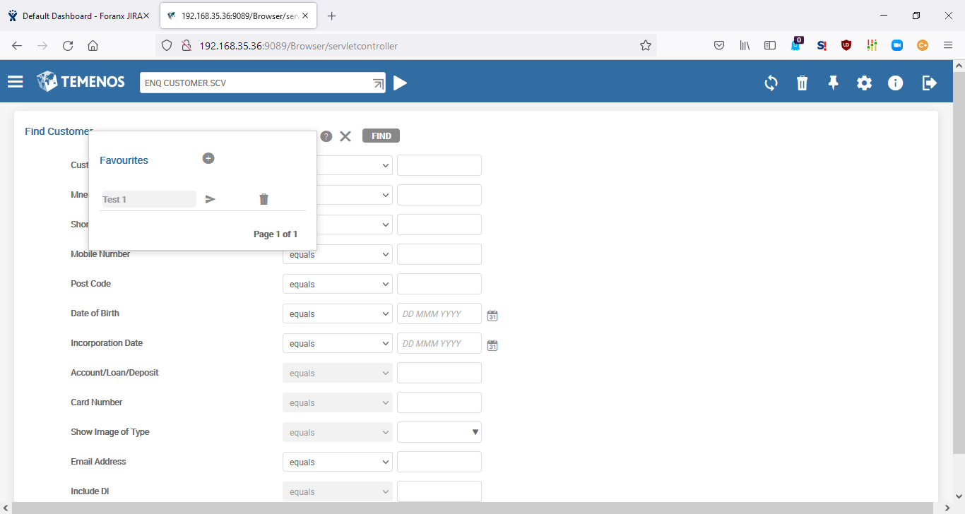
Enquiry - Enquiry selection – Sort Ordering
To avoid repeating filling in the Enquiry selection fields with the same data repetitively, the UXP Browser provides a favourites function.
After entering values into the selection fields, it is possible to remember them using icon.
Each set of values is stored using a unique name.
When you click the favourite icon, a list of existing favourites appears.
You can execute the previous selection values by clicking icon.
You can click to remove the favourites permanently.
You can click add a new favourite with the specified name. All the current selection fields are stored for execution in the future.

Slide 36
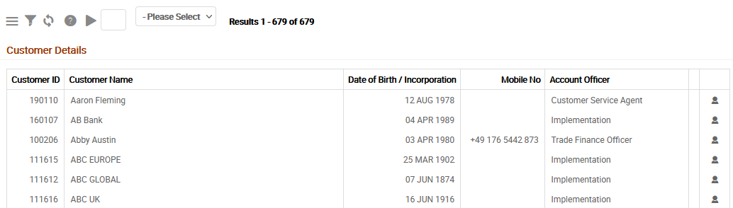
Enquiry - Enquiry Results Display
After Temenos Transact has executed the enquiry and returned the matching data, the UXP Browser displays the results screen. The enquiry data appears as a grid or table.
Each row could contain one or more drilldowns. If you click these drilldowns, the UXP browser navigates you to the corresponding screen.

Slide 37
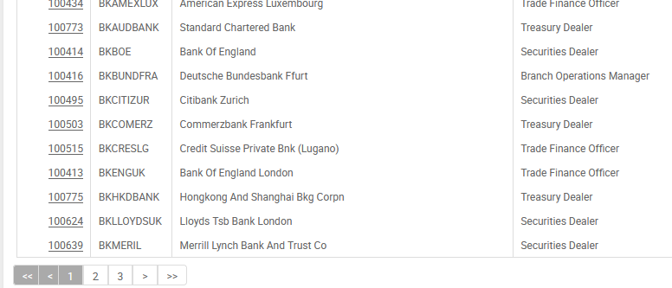
Enquiry - Enquiry Results Display
When the results are paged, a navigator is shown after the results table:

Slide 38
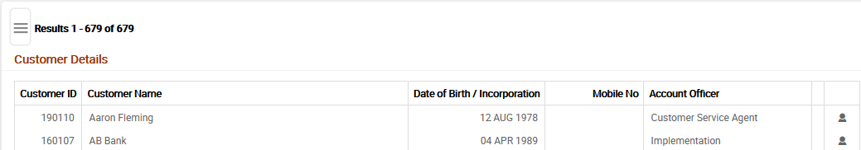
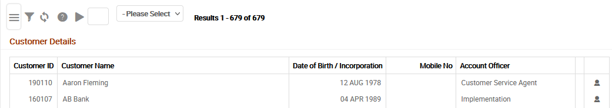
Enquiry - Enquiry Results Display
After you open an enquiry, Results Toolbar (highlighted) displays the options as shown in the following.
Results Toolbar . Single Click

Slide 39
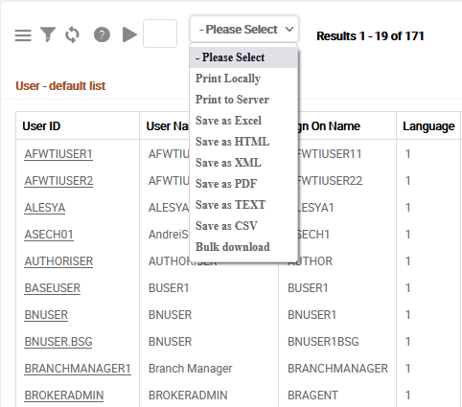
Saving Output
The Search or Enquiries result can be opened or saved as:
CSV (via «Bulk download»)
Output will be saved as Microsoft Excel Comma Separated File in any opted location
PDF
Output will be saved as “.pdf” file
Excel
Output will be saved as “.xlsx” file
Notes:
— The Search or Enquiries result can be opened or saved in any of the following methods.
CSV will have the output saved as Microsoft Excel Comma Separated File in any location specified by the user.
HTML will have the output saved as “.html” file in any opted location.
XML will have the output saved as “XML” file in any opted location.
The “Bulk download” functionality is designed to generate display-oriented CSV output similar to that produced by the existing “Save as CSV” option (but for a wider range of records).
Opportunity to save in Excel format is the new functionality in UXP.

Slide 40
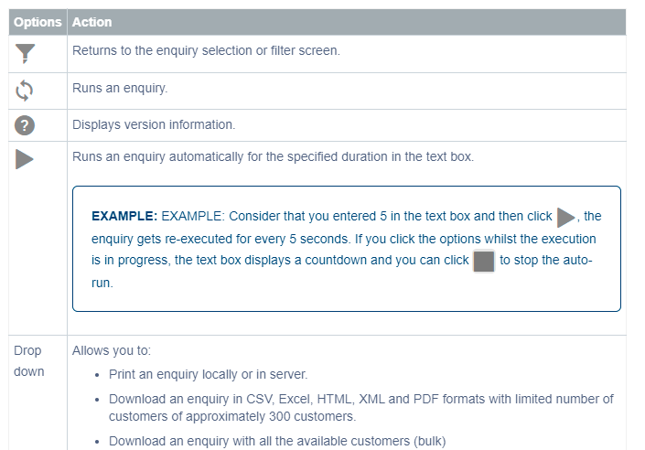
Enquiry - Enquiry Results Display

Slide 41
Abbreviations
Abbreviations are used to speed up launching Applications, Versions and Enquiries by entering a simplified name in the Command Line.
Abbreviations allow us to shorten the names of regularly used Applications, Versions and Enquiries
Input Reduction
Notes:
— Abbreviations are used to launch an Application, Version or Enquiry by entering a simplified name in the Command Line.
We have seen earlier how to open a new Customer record through COMMAND LINE
It is possible to reduce this further by creating an abbreviation for an application name or an application name with a specific function. (Next slide)

Slide 42
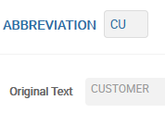
Creation of Abbreviations
Application ABBREVIATION
ABBREVIATION could contain:
Application/version (CUSTOMER)
Application + function (CUSTOMER I)
Application + function + record ID (CUSTOMER I 999999)
Enquiry (ENQ %CUSTOMER)
Name of Abbreviation as Record ID
Text for replacement

Slide 43
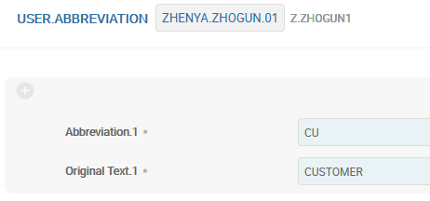
Creation of User Abbreviations
Application USER.ABBREVIATION
Application USER.ABBREVIATION contain personal abbreviations.
User ID, who uses
these Abbreviations
Name of Abbreviation
Text for replacement
If USER.ABBREVIATION and ABBREVIATION contain equal abbreviation, system will take User Abbreviation.

Slide 44
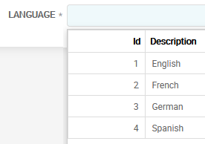

Multi-languages
What can be translated:
Standard text in the screen
Different messages, generated by Applications
Fields’ names in Applications
Menus
Delivery messages
Enquiries
Versions
Helptext (on server)
Multi-language fields

Slide 45


Methods of Translation — Overrides
OVERRIDE
Multi-language Fields
Override Message:

Slide 46



Methods of Translation — Errors
EB.ERROR
Multi-language Fields
Error:

Slide 47

Methods of Translation — VERSION
VERSION could contain multi-language names of the field. Versions will be discussed in more detail during one of the next lectures.

Slide 48



Methods of Translation — ENQUIRY
ENQUIRY could contain multi-language names of the field. Versions will be discussed in more detail during one of the next lectures.

Slide 49

Methods of Translation — DYNAMIC.TEXT
DYNAMIC.TEXT – Enquiry Content, some system messages
Multi-language Fields
Dynamic text records are automatically created in the unauthorised file when a foreign language user receives a message or prompt for which a translation cannot be found.
Notes:
— DYNAMIC.TEXT
Dynamic text records are automatically created in the unauthorised file when a foreign language user receives a message or prompt for which a translation cannot be found. The default would be in English, but these can be translated into the language of the User.
Also there are various general system messages not included in the list of 'GLOBAL.TEXT' from the STATIC.TEXT application.
(!!! THIS IS MOSTLY ABOUT OLD BROWSER WEB) Field names of each Application

Slide 50

Methods of Translation — DYNAMIC.TEXT
DYNAMIC.TEXT – example with Enquiry
T for TRANSLATE

Slide 51


Methods of Translation — DYNAMIC.TEXT
DYNAMIC.TEXT – example with Enquiry

Slide 52


Methods of Translation — STATIC.TEXT
STATIC.TEXT – General T24 System lettering and messages under the ID GLOBAL.TEXT
Notes:
—
STATIC.TEXT – General T24 System lettering and messages under the ID 'GLOBAL.TEXT’.
Also some written reports, where all field names and text would never change.
(!!! THIS IS MOSTLY ABOUT OLD BROWSER WEB) All the field names of each Application

Slide 53

Methods of Translation — STATIC.TEXT
STATIC.TEXT – General T24 System lettering and messages under the ID GLOBAL.TEXT
Note: The item (45) 'PLEASE ENTER YOUR SIGN ON NAME' and (57) 'PLEASE ENTER YOUR PASSWORD' uses the English Text only, since at this point the user has not yet signed in and their language is not determined. If all or most of the users are not English, the English version of these values can be changed to the local language.

Slide 54

Auto ID Start
T24 can automatically define the ID of the next new record in different Applications
To set up automatic creation of IDs – application AUTO.ID.START is used
Automatic creation of IDs is often used for:
Accounts’ Numbers
Contracts
Customers’ Numbers
Notes:
— Let us look at the way the transaction and record numbering system is allocated within T24.
Application AUTO.ID.START is where all the transaction numbers and record numbers are constructed.
These would include account numbers, contract numbers, transaction numbers and customer numbers.
Each number MUST be unique.
ID.START: This field is the key of the application file from which auto-numbering is to start. It can contain upto 35 alphanumeric characters. It is a multivalue field associated with application. It is a mandatory field.
UNIQUE NO: Generation of transaction id's based on system generated values. The presence of such a record will trigger the auto generation of sequences using default characters (1-9 and B-Z - excluding vowels). Dependent on the use of the BASE.TABLE and ID.LENGTH fields, the sequence generated will contain alpha, numeric or both in the key, subject to the length allowed.

Slide 55


Auto ID Start

Slide 56


Auto ID Start

Slide 57

Auto ID Start
For working of automatic creation of IDs in an Application — this Application must be mentioned in the field PGM.AUTOM.ID of COMPANY application

Slide 58


RECORD.LOCK — Unlock the record
Step 1
Step 2

Slide 59
Workshop - 1
Log into the System
Launch application ACCOUNT
Check how abbreviation ACC works
Open an existing record with ‘See’ function
Open this record with ‘Edit’ function
Modify the Account name in this opened record
Save modified data into the System
Delete your modifications made
Create new record (try to use automatic and/or manual ID creation)
Fill in all mandatory fields
Fill in Account name in several languages
Check the correctness of the inputted data
Save data into the System
Authorize new record (with another USER profile or ask your colleague to authorize your record)
Identify the quantity of Branches that are setup in Model Bank
Identify the current date in Model Bank

Slide 60

Types of File — FILE.CONTROL
Applications in T24 are broadly classified into three types OF CLASSES INT, CUS and FIN.
Classification is done when application is designed
Type defines if the application can be shared between Company.
Notes:
. Applications in T24 are broadly classified into three types OF CLASSES INT, CUS and FIN. There are other sub-types too, but are not in the scope of this learning unit.
1.1 INT Application Files, which are usually parameter tables or static tables that are common to all companies in the installation fall under this category. For example SPF, PROTOCOL, COMPANY etc where only one file exists at database level regardless of the number of companies.
1.2 FIN Application files store financial data. For example ACCOUNT, LD.LOANS.AND.DEPOSITS etc. Financial information is always stored specific to a particular company. Thus these type of applications will require multiple files at database level depending on the number of companies.
1.3 CUS Application files store customer related information. T24 gives the bank two options of storing this type of data. The first option being similar to the INT type where there will only be one file at database level irrespective of the number of companies if the data is to be shared among the companies or multiple files at database level to store company specific data if data is not shared between companies.
2. The FILE.CONTROL application contains data about which classification an application falls under.

Slide 61

Possible configurations for the system
Notes:
As shown in the illustration, the Financial files are not shared. Files of type FIN are exclusively maintained for each Branch. Installation files are always shared by all the branches of the bank. As represented in the figure, there is only one set of the files whose type is INT, shared by all branches. Customer files can be configured to be shared between branches or Not shared. As shown Branch 1 and Branch 2 share the files with type = CUS, whereas branch 3 has its own copy of Customer files. Like CUS types, the FIN type files can also be configured to be shared between some branches and exclusive for some. Where can these configurations be defined? In the COMPANY record for the Branch.

Slide 62
File naming conventions
Other file types | Installation type
All file types other than installation type are company specific | They are not company specific and have only one set of files
Can be configured to be shared across companies during company installation | No configuration possible – always shared
Naming convention for such files would be F<ComMne>.<APPLICATION> | Naming convention for such files is F.<APPLICATION>
Ex : FBR1.ACCOUNT, FBR2.ACCOUNT FBR1.CUSTOMER etc | Ex: F. SPF
Notes:
CUS type of files store customer related details.
These files can be shared by companies or each company can have its own file.
Syntax of the file name would be F<MNEMONIC>.<APPLICATION>. For example, FBNK.CUSTOMER
FIN type of files or applications stores the financial information related to a company.
FIN files are not shared. Financial information as a practice is stored company wise. Financial information is crucial in deciding the “health” of the Bank and its branches and thus is stored company wise.
As these files are company specific, the mnemonic of the company is a part of the file name to identify to which company the files belong to.
Syntax of the file name would be F<MNEMONIC>.<APPLICATION>. For example, FBNK.ACCOUNT
INT type of files or applications are specific to one T24 installation.
Such type of files are not company specific and have only one file in the first Lead Company irrespective of the number of branches in an installation.
All the other Lead and Branch companies can access these type of files.
As these files are installation specific, the company mnemonic is not part of the file name. The syntax is F.<APPLICATION>.
For example, F.SPF, F.COMPANY are some INT type of files.

Slide 63
Thank you for your time and attention!
FORANX LLC
Legal address:
35A, Ponomarenko str., 201 office, Minsk, 220015, Belarus
Tel.:+ 375 17 202 76 78
+ 375 17 202 76 79
Fax: + 375 17 362 34 22
Web-site: www.foranx.by
Minsk, 2021

